Slide 1
3D model-based Semantic Annotation Management Research and Application
Do Nhat Quang

Slide 2
Menu
Background
Solution
Demo
1
2
3
4
5
6
Problem
Prototype
Summary

Slide 3
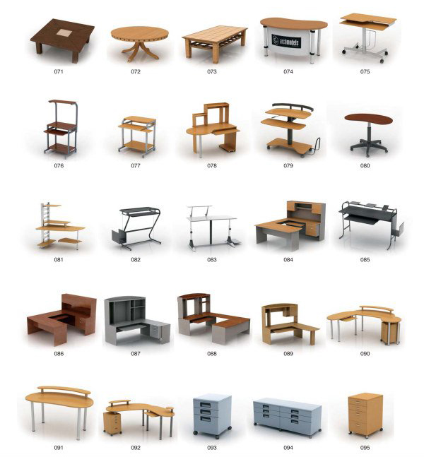
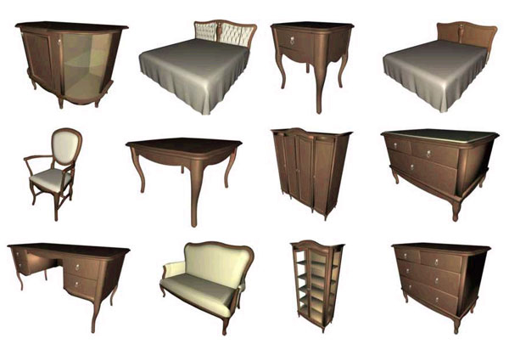
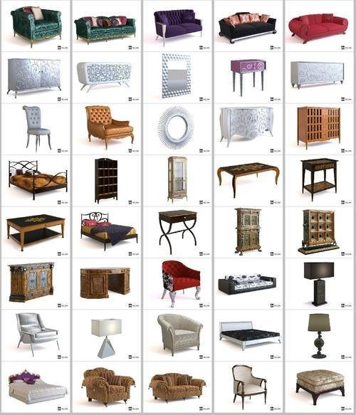
3D Modelling
Notes:
1. Transfer 2d=>3D Tool
2. 3D Modeling Plat-form
=> Too much of 3d Model

Slide 4
Problem
Big amount of 3d model need to be defined
Difficult to manage resource and modelling
WebGL 3D Model have not XML structure
Need the high performance solution to 3d model semantic annotation automatically
Notes:
Too much of 3d Model
Need to manager for using better, high efficient

Slide 5
Semantic
Tags
Picture
Video
Blue
Slides
Questions
Company
PowerPoint
Workflow
Images
Template
Colour
Editable
Chart
Grey
Retro-style
Agenda
Bubbles
Frame
Icons
Comparison
Personalised

Slide 6
Solution
Auto 3D Model print screenshot to image (WebGL, X3D or any format base on HMTL Canvas)
Auto Image Analyze and Comparison method
The Images recognition method base on Internet
Implement API of the image auto semantic
For high performance of images semantic annotation automatically

Slide 7
Solution
Comparison
VS
3D
3D Model
Screenshot
Semantic
Recognition
Notes:
Comparison + Recognition => Auto Semantic API

Slide 8
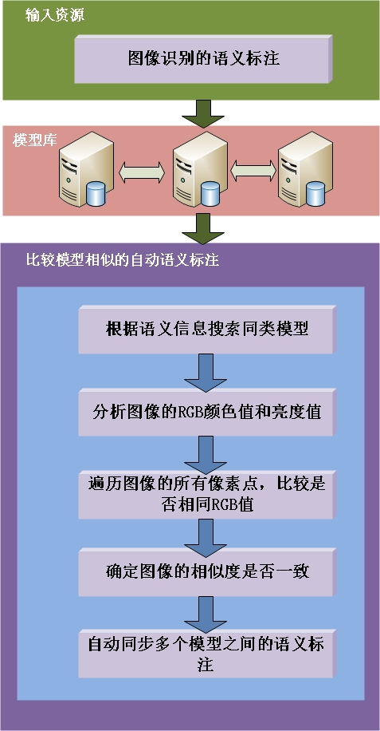
Image Comparison Semantic Method
Image Comparison Auto Semantic of System Structure
Input 3D Model (WebGL, X3D, …)
Auto convert 3d Model to normal images
Analyse Images and Compare with another in DB

Slide 9
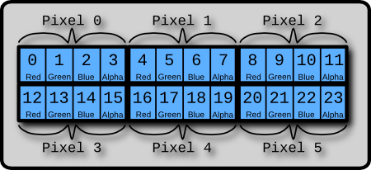
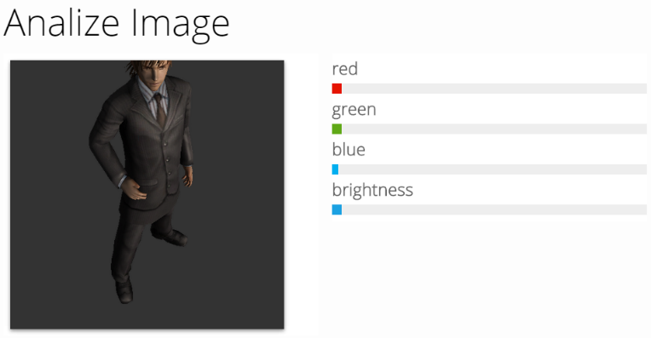
Image Analyse
Base on HTML Canvas of Image Analyze Algorithm
Analyze the image of pixels color and brightness value
Image Pixels of Color Value

Slide 10
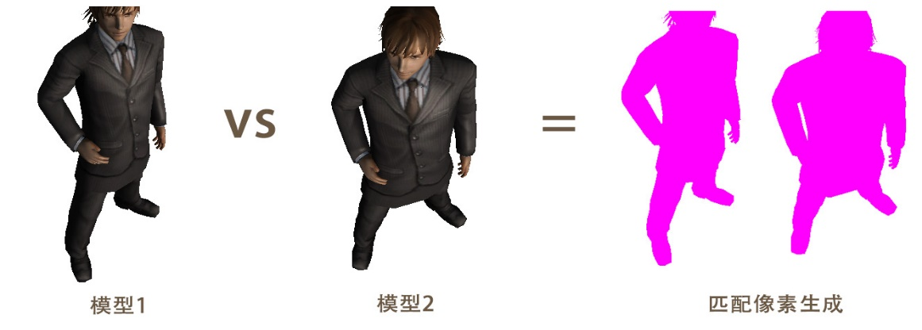
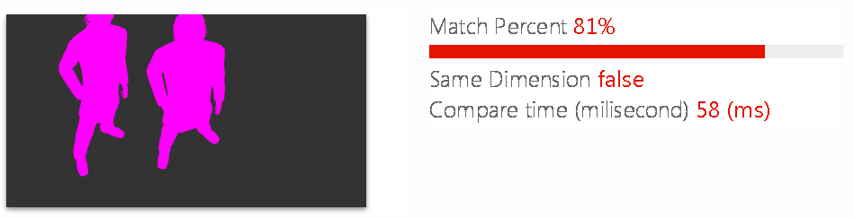
Image Compare
The Comparison two image of similar
Comparison result

Slide 11
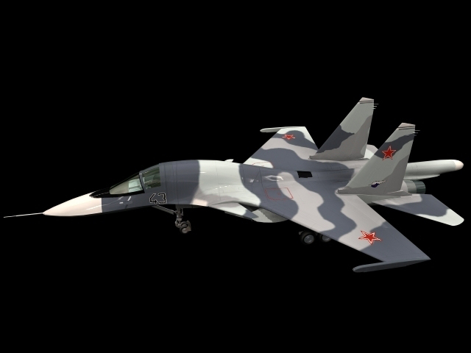
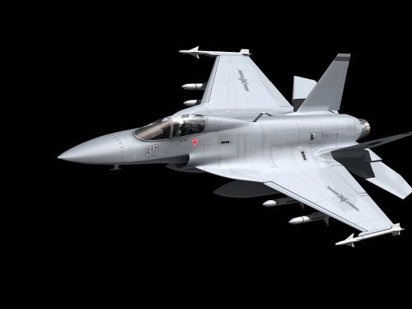
Image Comparison Semantic Method
VS
80%

Slide 12
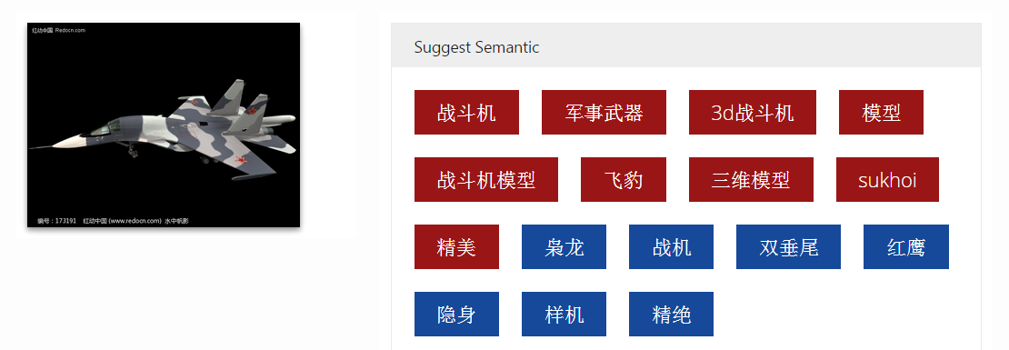
Image Comparison Semantic Method
{
}
"战斗机", "军事武器", "3d战斗机", "模型", "战斗机模型", "飞豹", "三维模型", "sukhoi", "精美", "枭龙", "战机", "双垂尾", "红鹰", "隐身", "样机", "精绝“

Slide 13
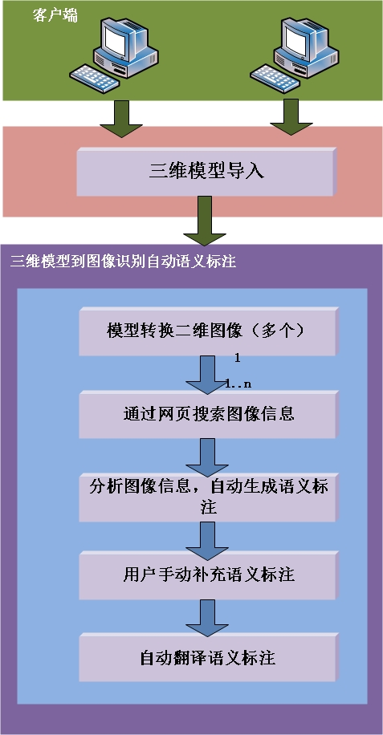
Image Recognition Semantic Method
Image Recognition Auto Semantic of System Structure
Input normal images
Find the similar of images through Internet
Analyse information and get semantic
User manually Inputting
Auto Translate Semantic

Slide 14
Result
3D Model Semantic result
Explanation
Get Semantic Time | Semantic Amout | Unit
901 | 10 | ms
849 | 9 | ms
1430 | 8 | ms
1480 | 9 | ms
2230 | 11 | ms
1790 | 10 | ms
8.68 | 57 | s
About 1~2 second response for per semantic image times
The Semantic amount is about 10 for per times
In that case, the system provide 57 semantics in about 8.6 second
Notes:
Most powerful than Manual Semantic Annotation

Slide 15
Result
Auto image semantic annotation result

Slide 16
Result
Getting Semantic annotation of efficiency

Slide 17
Solution - Extension
But sometime the 3D Model resources are not enough for our working
Need semantic annotation some other resource but only 3D Model
Example Video, Mobile Photos, …
We need some powerful of Auto Semantic API to resolve

Slide 18

Auto Semantic API
Semantic API
API
Similar Images
3D
Semantic
Notes:
Comparison + Recognition => Auto Semantic API

Slide 19
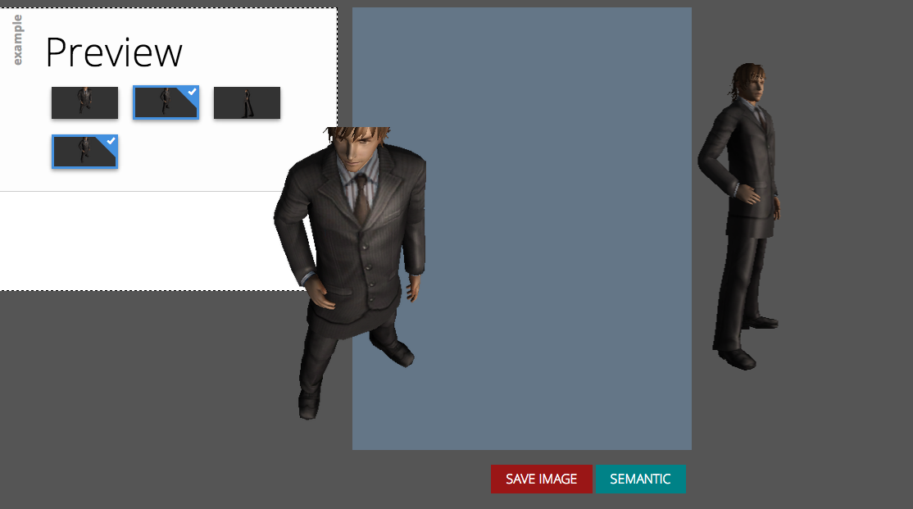
Prototype
Auto 3d model print screenshot
Notes:
通过前台使用Javascript实现算法以及HTML Canvas分析二维图像的RGB & Alpha值以及亮度值。
图像比较方法使用像素扫描方式来对比两个像素结构中的颜色值是否相等。
每次循环若像素不相同则
生成相差的像素点。
相同值点叠加1

Slide 20
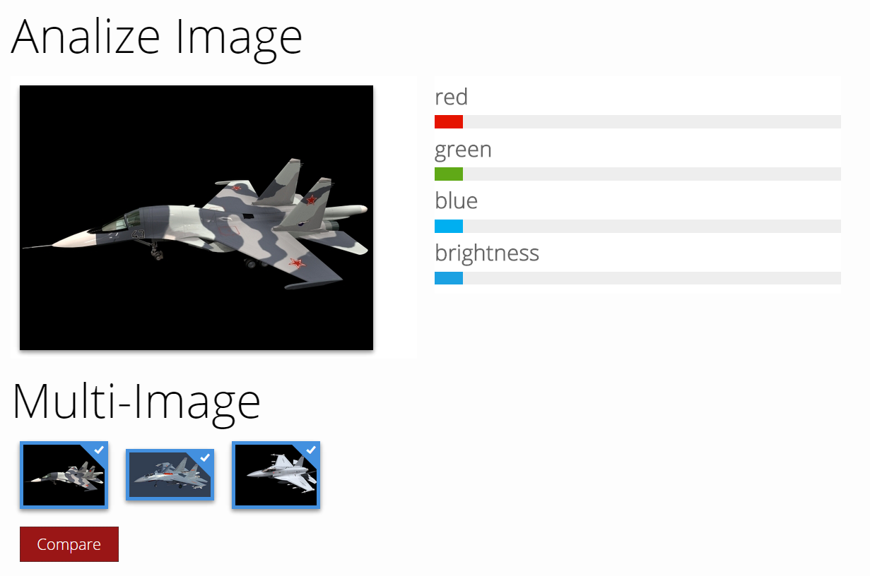
Prototype
Analyze Images of pixels color

Slide 21
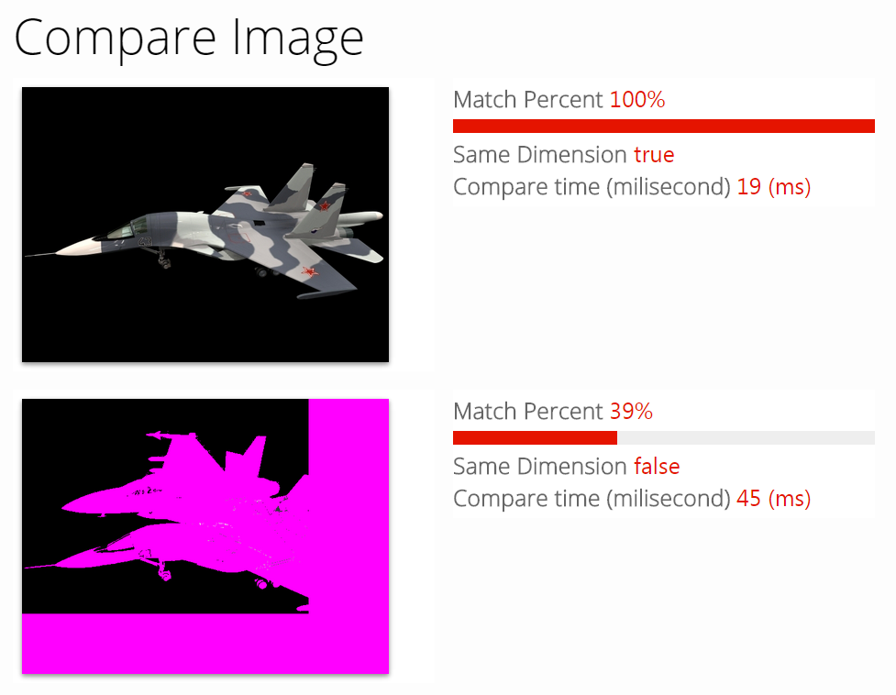
Prototype
Image comparison results

Slide 22
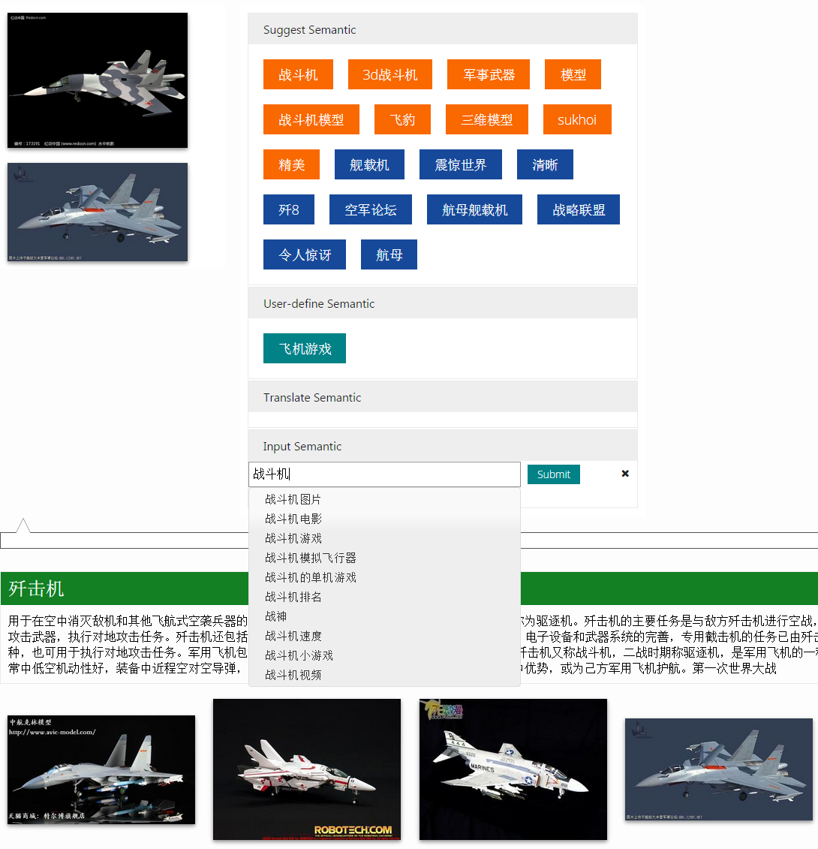
Prototype
Semantic tags
User define tags
Auto suggest for semantic inputting
Model information and
Similar suggest
Notes:
通过前台使用Javascript实现算法以及HTML Canvas分析二维图像的RGB & Alpha值以及亮度值。
图像比较方法使用像素扫描方式来对比两个像素结构中的颜色值是否相等。
每次循环若像素不相同则
生成相差的像素点。
相同值点叠加1

Slide 23
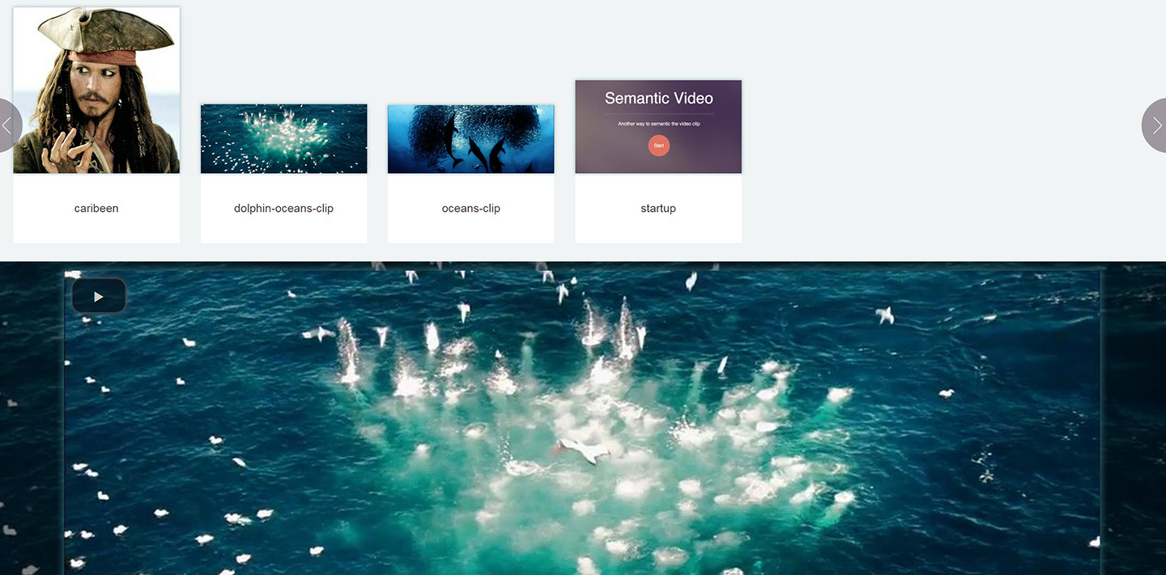
Prototype
Video Semantic Manager
Video Player Area
Video Auto Semantic Base on Image recognition
Notes:
通过前台使用Javascript实现算法以及HTML Canvas分析二维图像的RGB & Alpha值以及亮度值。
图像比较方法使用像素扫描方式来对比两个像素结构中的颜色值是否相等。
每次循环若像素不相同则
生成相差的像素点。
相同值点叠加1

Slide 24
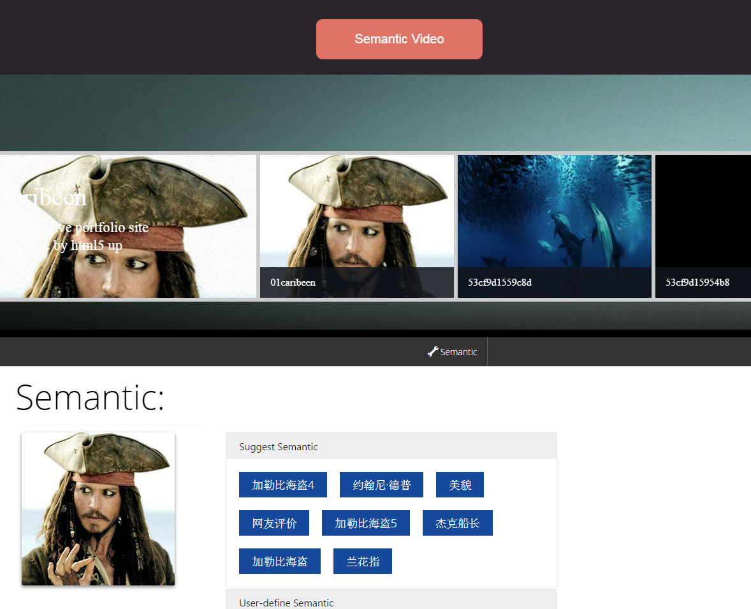
Prototype
Video Image Auto Screenshot
Semantic tags
Notes:
视频自动截图
针对截的图片来添加语义标注

Slide 25




Summary
3D Model & Video
Auto Semantic
High perform of
Image Analyse
and Comparison
Image
Recognition
Auto Semantic API

Slide 26




Who am I?
Email: donhatquang@gmail.com
Profile:
donhatquang
Google plus:
Do Nhat Quang
Blog:
donhatquang
About.me:
13661755647

Slide 27
Questions & Answer

